Slide 1
Update: Piezo-energy harvesting
Chongan Wang
2024-11-22

Slide 2
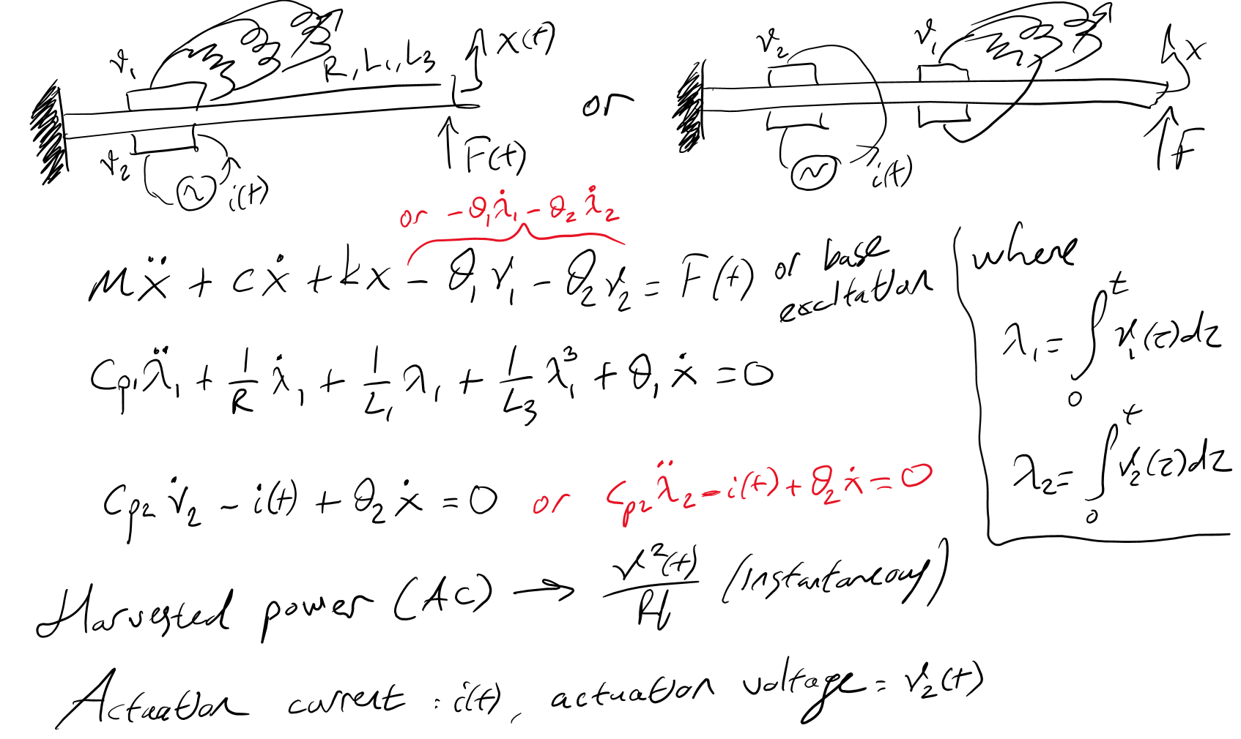
System Description
Conceptual idea:
We consider a cantilever beam with base excitation for energy harvesting
Two piezoelectric patches are bonded onto the cantilever beam
One pair of piezo-patches are shunted with resistor inductor circuits as the energy harvestor
An electric input is applied on the other piezoelectric patches that slowly modulates the effective amplitude of the excitation

Slide 3
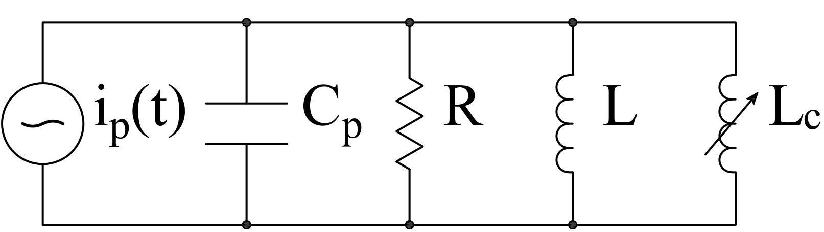
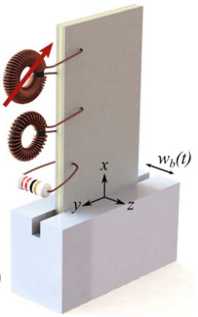

Schematic
$$v\left(t\right)$$
We consider two piezoelectric patches
A voltage signal is applied on the piezoelectric patch near the tip
The piezoelectric patches near the base is shunted by the following nonlinear circuit
Previous work in Obaidullah’s paper

Slide 4




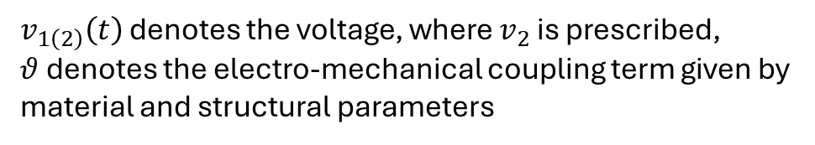
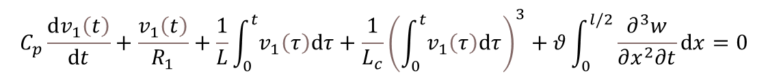
EOM
$$x=l$$
Bending moment
$$M=−YI\frac{∂^{2}w}{∂x^{2}}+θv_{1}\left(t\right)\left[H\left(x\right)−H\left(x−\frac{l}{2}\right)\right]+θv_{2}\left(t\right)\left[H\left(x−\frac{l}{2}\right)−H\left(x−l\right)\right]$$
$$v\left(t\right)$$
Neglect structural damping
$$−\frac{∂^{2}M}{∂x^{2}}+m\frac{∂^{2}w}{∂t^{2}}=0$$
$$x=\frac{l}{2}$$
Circuit equation
$$C_{p}\frac{dv_{1}\left(t\right)}{dt}+\frac{v_{1}\left(t\right)}{R_{1}}+\frac{1}{L}\int_{0}^{t}{v_{1}\left(τ\right)dτ}+\frac{1}{L_{c}}{\left(\int_{0}^{t}{v_{1}\left(τ\right)dτ}\right)}^{3}+θ\int_{0}^{l/2}{\frac{∂^{3}w}{∂x^{2}∂t}dx}=0$$
$v_{1\left(2\right)}\left(t\right)$ denotes the voltage, where $v_{2}$ is prescribed,
$θ$ denotes the electro-mechanical coupling term given by material and structural parameters
$$w=w_{b}\left(t\right)+w_{rel}\left(x,t\right)$$
Base excitation
Relative displacement

Slide 5
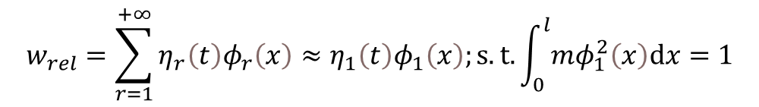
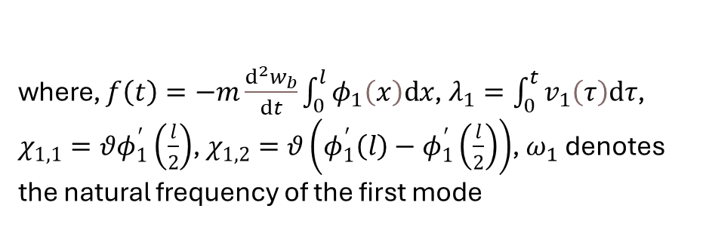
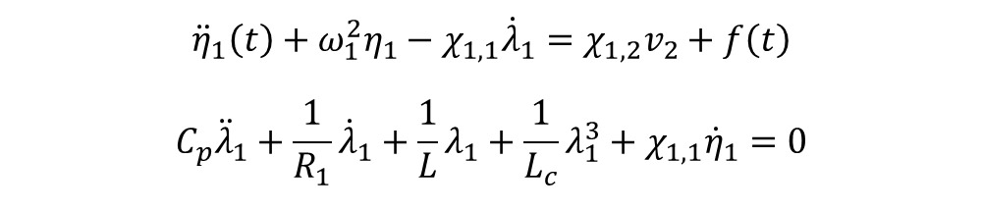
ROM
$$w=w_{b}\left(t\right)+w_{rel}\left(x,t\right)$$
$$x=l$$
We assume that the beam deflection is approximated by the first mode of a cantilever beam,
$$v\left(t\right)$$
$$w_{rel}=\sum_{r=1}^{+∞}{η_{r}\left(t\right)φ_{r}\left(x\right)}≈η_{1}\left(t\right)φ_{1}\left(x\right);s.t.\int_{0}^{l}{mφ_{1}^{2}\left(x\right)dx}=1$$
$$x=\frac{l}{2}$$
ROM equation,
$${\ddot{η}}_{1}\left(t\right)+ω_{1}^{2}η_{1}−χ_{1,1}{\dot{λ}}_{1}=χ_{1,2}v_{2}+f\left(t\right)$$
$$C_{p}{\ddot{λ}}_{1}+\frac{1}{R_{1}}{\dot{λ}}_{1}+\frac{1}{L}λ_{1}+\frac{1}{L_{c}}λ_{1}^{3}+χ_{1,1}{\dot{η}}_{1}=0$$
where, $f\left(t\right)=−m\frac{d^{2}w_{b}}{dt}\int_{0}^{l}{φ_{1}\left(x\right)dx}$, $λ_{1}=\int_{0}^{t}{v_{1}\left(τ\right)dτ}$, $χ_{1,1}=θφ_{1}^{′}\left(\frac{l}{2}\right)$, $χ_{1,2}=θ\left(φ_{1}^{′}\left(l\right)−φ_{1}^{′}\left(\frac{l}{2}\right)\right)$, $ω_{1}$ denotes the natural frequency of the first mode

Slide 6
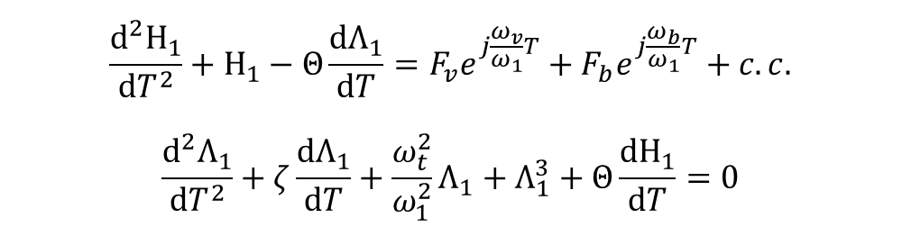

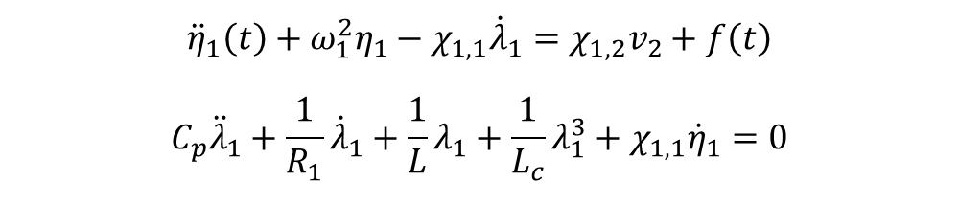



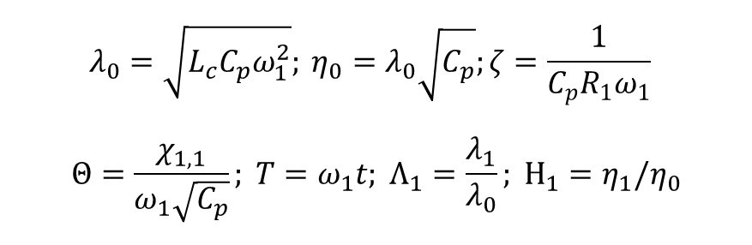
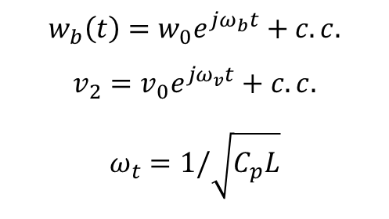
Normalized ROM
$$x=l$$
$$v\left(t\right)$$
$$F_{b}=\frac{mω_{b}^{2}w_{0}\int_{0}^{l}{φ_{1}\left(x\right)dx}}{ω_{1}^{2}η_{0}}$$
$$F_{v}=Θ\frac{χ_{1,2}v_{0}}{χ_{1,1}ω_{1}λ_{0}}$$
$${\ddot{η}}_{1}\left(t\right)+ω_{1}^{2}η_{1}−χ_{1,1}{\dot{λ}}_{1}=χ_{1,2}v_{2}+f\left(t\right)$$
$$C_{p}{\ddot{λ}}_{1}+\frac{1}{R_{1}}{\dot{λ}}_{1}+\frac{1}{L}λ_{1}+\frac{1}{L_{c}}λ_{1}^{3}+χ_{1,1}{\dot{η}}_{1}=0$$
$$x=\frac{l}{2}$$
$$w_{b}\left(t\right)=w_{0}e^{jω_{b}t}+c.c.$$
$$v_{2}=v_{0}e^{jω_{v}t}+c.c.$$
$$ω_{t}=1/\sqrt{C_{p}L}$$
$$λ_{0}=\sqrt{L_{c}C_{p}ω_{1}^{2}}; η_{0}=λ_{0}\sqrt{C_{p}};ζ=\frac{1}{C_{p}R_{1}ω_{1}}$$
$$Θ=\frac{χ_{1,1}}{ω_{1}\sqrt{C_{p}}}; T=ω_{1}t; Λ_{1}=\frac{λ_{1}}{λ_{0}}; Η_{1}=η_{1}/η_{0}$$
$$\frac{d^{2}Η_{1}}{dT^{2}}+Η_{1}−Θ\frac{dΛ_{1}}{dT}=F_{v}e^{j\frac{ω_{v}}{ω_{1}}T}+F_{b}e^{j\frac{ω_{b}}{ω_{1}}T}+c.c.$$
$$\frac{d^{2}Λ_{1}}{dT^{2}}+ζ\frac{dΛ_{1}}{dT}+\frac{ω_{t}^{2}}{ω_{1}^{2}}Λ_{1}+Λ_{1}^{3}+Θ\frac{dΗ_{1}}{dT}=0$$

Slide 7

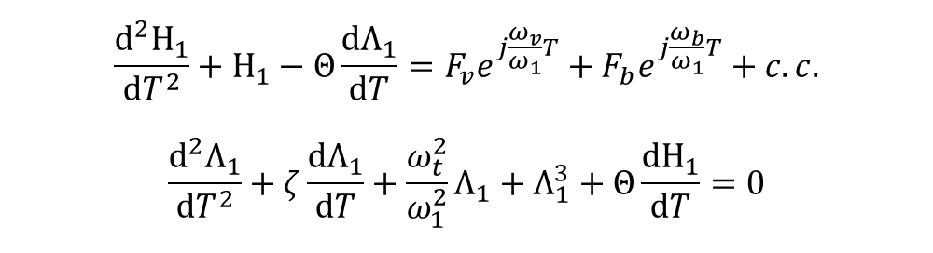


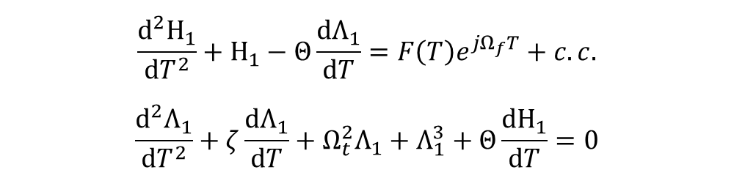
Normalized ROM
$$x=l$$
$$v\left(t\right)$$
$$\frac{d^{2}Η_{1}}{dT^{2}}+Η_{1}−Θ\frac{dΛ_{1}}{dT}=F_{v}e^{j\frac{ω_{v}}{ω_{1}}T}+F_{b}e^{j\frac{ω_{b}}{ω_{1}}T}+c.c.$$
$$\frac{d^{2}Λ_{1}}{dT^{2}}+ζ\frac{dΛ_{1}}{dT}+\frac{ω_{t}^{2}}{ω_{1}^{2}}Λ_{1}+Λ_{1}^{3}+Θ\frac{dΗ_{1}}{dT}=0$$
$$x=\frac{l}{2}$$
Quasi-periodic excitation:
$$F_{v}e^{j\frac{ω_{v}}{ω_{1}}T}+F_{b}e^{j\frac{ω_{b}}{ω_{1}}T}=\left(F_{v}e^{j\frac{ω_{v}−ω_{b}}{ω_{1}}T}+F_{b}\right)e^{j\frac{ω_{b}}{ω_{1}}T}$$
In the analysis, we assume that $F_{v}e^{j\frac{ω_{v}−ω_{b}}{ω_{1}}T}+F_{b}$ is a slowly-varying term.
$$\frac{ω_{b}}{ω_{1}}=Ω_{f}$$
$$\frac{d^{2}Η_{1}}{dT^{2}}+Η_{1}−Θ\frac{dΛ_{1}}{dT}=F\left(T\right)e^{jΩ_{f}T}+c.c.$$
$$\frac{d^{2}Λ_{1}}{dT^{2}}+ζ\frac{dΛ_{1}}{dT}+Ω_{t}^{2}Λ_{1}+Λ_{1}^{3}+Θ\frac{dΗ_{1}}{dT}=0$$
$$\frac{ω_{t}^{2}}{ω_{1}^{2}}=Ω_{t}^{2}$$

Slide 8

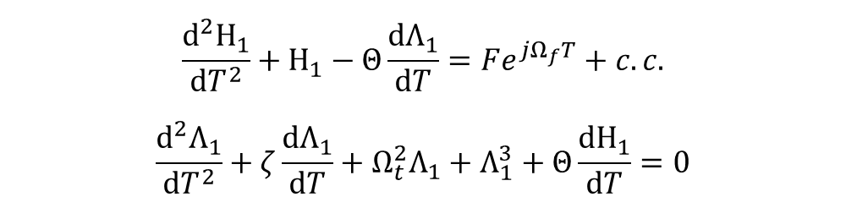

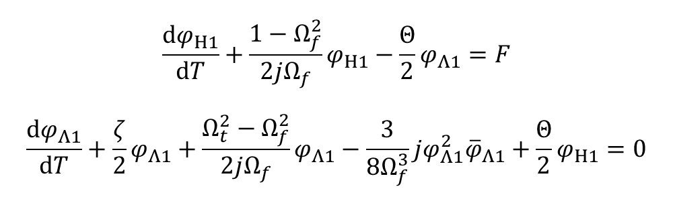
CX-A
$$x=l$$
$$v\left(t\right)$$
$$\frac{d^{2}Η_{1}}{dT^{2}}+Η_{1}−Θ\frac{dΛ_{1}}{dT}=Fe^{jΩ_{f}T}+c.c.$$
$$\frac{d^{2}Λ_{1}}{dT^{2}}+ζ\frac{dΛ_{1}}{dT}+Ω_{t}^{2}Λ_{1}+Λ_{1}^{3}+Θ\frac{dΗ_{1}}{dT}=0$$
$$x=\frac{l}{2}$$
Ansatz:
$$ψ_{Η1}=\frac{dΗ_{1}}{dT}+jΩ_{f}Η_{1}=φ_{Η1}e^{jΩ_{f}T}$$
$$ψ_{Λ1}=\frac{dΛ_{1}}{dT}+jΩ_{f}Λ_{1}=φ_{Λ1}e^{jΩ_{f}T}$$
Average out $e^{jΩ_{f}T}$terms:
$$\frac{dφ_{Η1}}{dT}+\frac{1−Ω_{f}^{2}}{2jΩ_{f}}φ_{Η1}−\frac{Θ}{2}φ_{Λ1}=F$$
$$\frac{dφ_{Λ1}}{dT}+\frac{ζ}{2}φ_{Λ1}+\frac{Ω_{t}^{2}−Ω_{f}^{2}}{2jΩ_{f}}φ_{Λ1}−\frac{3}{8Ω_{f}^{3}}jφ_{Λ1}^{2}{\overline{φ}}_{Λ1}+\frac{Θ}{2}φ_{Η1}=0$$

Slide 9

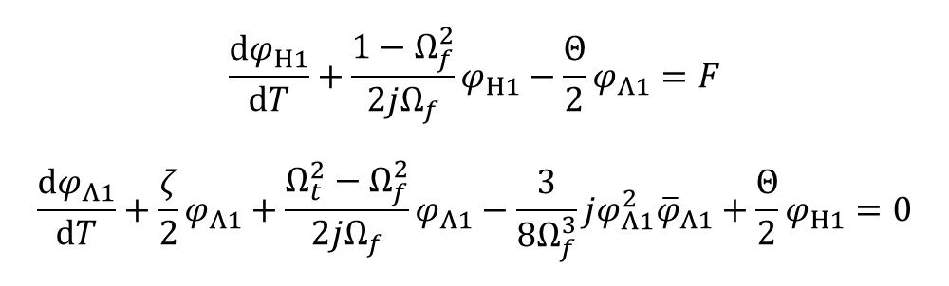
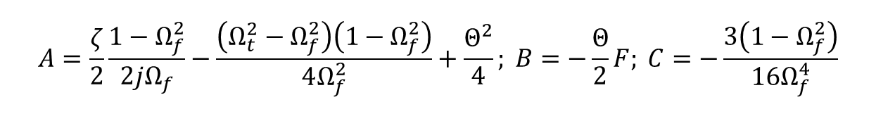
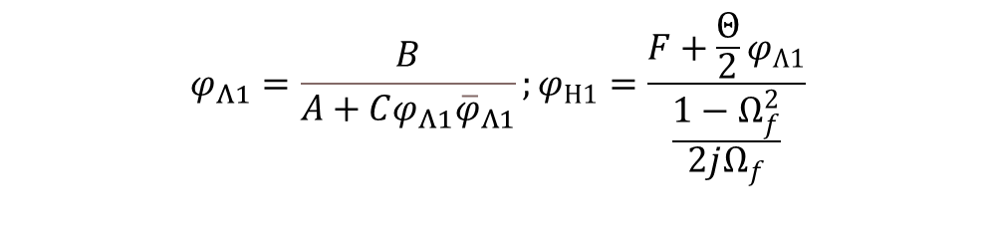
Steady-state
$$x=l$$
$$v\left(t\right)$$
$$\frac{dφ_{Η1}}{dT}+\frac{1−Ω_{f}^{2}}{2jΩ_{f}}φ_{Η1}−\frac{Θ}{2}φ_{Λ1}=F$$
$$\frac{dφ_{Λ1}}{dT}+\frac{ζ}{2}φ_{Λ1}+\frac{Ω_{t}^{2}−Ω_{f}^{2}}{2jΩ_{f}}φ_{Λ1}−\frac{3}{8Ω_{f}^{3}}jφ_{Λ1}^{2}{\overline{φ}}_{Λ1}+\frac{Θ}{2}φ_{Η1}=0$$
$$x=\frac{l}{2}$$
$$\frac{dφ_{Η1}}{dT}=\frac{dφ_{Λ1}}{dT}=0$$
$$C^{2}{\left(φ_{Λ1}{\overline{φ}}_{Λ1}\right)}^{3}+\left(A+\overline{A}\right)C{\left(φ_{Λ1}{\overline{φ}}_{Λ1}\right)}^{2}+A\overline{A}φ_{Λ1}{\overline{φ}}_{Λ1}=B\overline{B}$$
$$φ_{Λ1}=\frac{B}{A+Cφ_{Λ1}{\overline{φ}}_{Λ1}};φ_{Η1}=\frac{F+\frac{Θ}{2}φ_{Λ1}}{\frac{1−Ω_{f}^{2}}{2jΩ_{f}}}$$
$$A=\frac{ζ}{2}\frac{1−Ω_{f}^{2}}{2jΩ_{f}}−\frac{\left(Ω_{t}^{2}−Ω_{f}^{2}\right)\left(1−Ω_{f}^{2}\right)}{4Ω_{f}^{2}}+\frac{Θ^{2}}{4}; B=−\frac{Θ}{2}F; C=−\frac{3\left(1−Ω_{f}^{2}\right)}{16Ω_{f}^{4}}$$

Slide 10

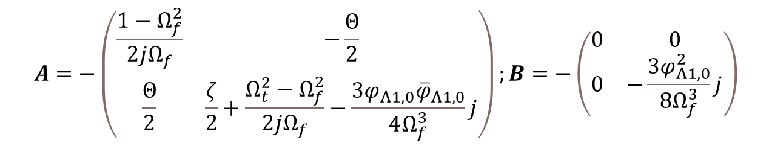

Stability analysis
$$x=l$$
$$v\left(t\right)$$
$$\frac{dφ_{Η1}}{dT}+\frac{1−Ω_{f}^{2}}{2jΩ_{f}}φ_{Η1}−\frac{Θ}{2}φ_{Λ1}=F$$
$$\frac{dφ_{Λ1}}{dT}+\frac{ζ}{2}φ_{Λ1}+\frac{Ω_{t}^{2}−Ω_{f}^{2}}{2jΩ_{f}}φ_{Λ1}−\frac{3}{8Ω_{f}^{3}}jφ_{Λ1}^{2}{\overline{φ}}_{Λ1}+\frac{Θ}{2}φ_{Η1}=0$$
$$x=\frac{l}{2}$$
$$φ_{Η1}=φ_{Η1,0}+φ_{Η1}$$
$$φ_{Λ1}=φ_{Λ1,0}+φ_{Λ1}$$
$$\frac{d}{dT}\left(\begin{matrix}φ_{Η1} \\ φ_{Λ1}\end{matrix}\right)=A\left(\begin{matrix}φ_{Η1} \\ φ_{Λ1}\end{matrix}\right)+B\left(\begin{matrix}{\overline{φ}}_{Η1} \\ {\overline{φ}}_{Λ1}\end{matrix}\right)$$
Real parts of the eigenvalue of the matrix $\left(\begin{matrix}A & B \\ \overline{B} & \overline{A}\end{matrix}\right)$ are negative
$$A=−\left(\begin{matrix}\frac{1−Ω_{f}^{2}}{2jΩ_{f}} & −\frac{Θ}{2} \\ \frac{Θ}{2} & \frac{ζ}{2}+\frac{Ω_{t}^{2}−Ω_{f}^{2}}{2jΩ_{f}}−\frac{3φ_{Λ1,0}{\overline{φ}}_{Λ1,0}}{4Ω_{f}^{3}}j\end{matrix}\right);B=−\left(\begin{matrix}0 & 0 \\ 0 & −\frac{3φ_{Λ1,0}^{2}}{8Ω_{f}^{3}}j\end{matrix}\right)$$

Slide 11
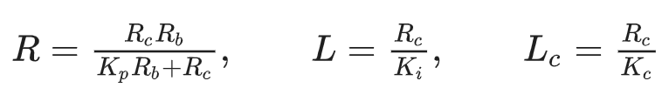
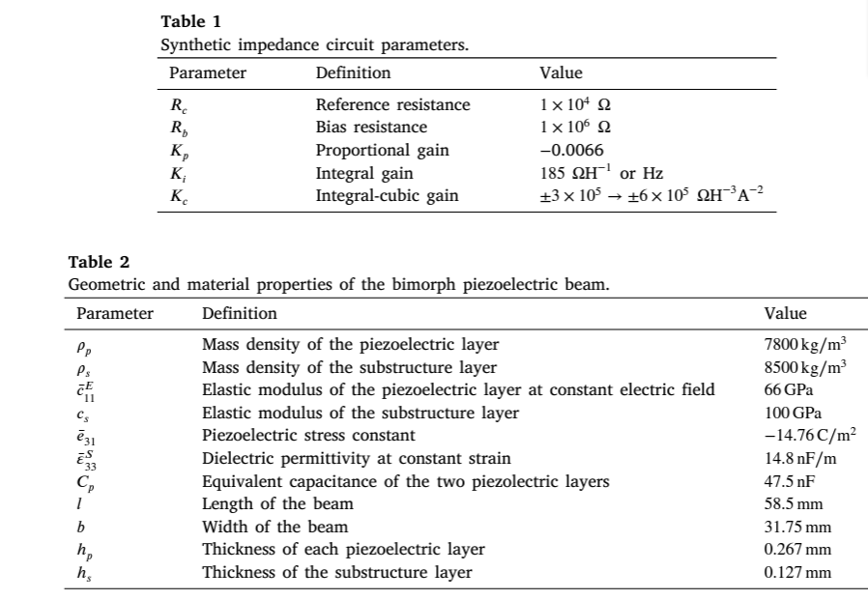

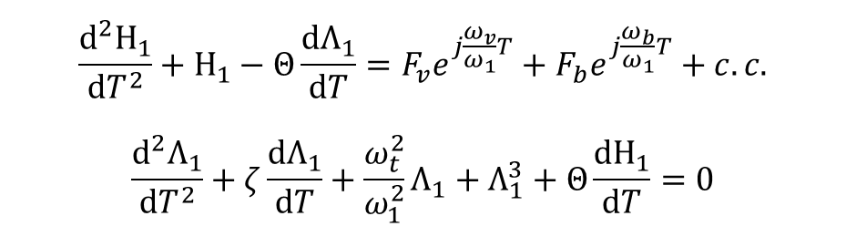



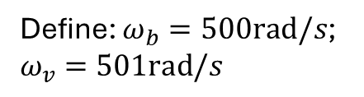
Numerical Confirmation
Previous work in Obaidullah’s paper
$$\frac{d^{2}Η_{1}}{dT^{2}}+Η_{1}−Θ\frac{dΛ_{1}}{dT}=F_{v}e^{j\frac{ω_{v}}{ω_{1}}T}+F_{b}e^{j\frac{ω_{b}}{ω_{1}}T}+c.c.$$
$$\frac{d^{2}Λ_{1}}{dT^{2}}+ζ\frac{dΛ_{1}}{dT}+\frac{ω_{t}^{2}}{ω_{1}^{2}}Λ_{1}+Λ_{1}^{3}+Θ\frac{dΗ_{1}}{dT}=0$$
$$K_{i}=185/2$$
$$ζ=0.0233$$
$$ω_{1}=566.44rad/s$$
$$ω_{t}=599.48rad/s$$
Define: $ω_{b}=500rad/s$; $ω_{v}=501rad/s$

Slide 12

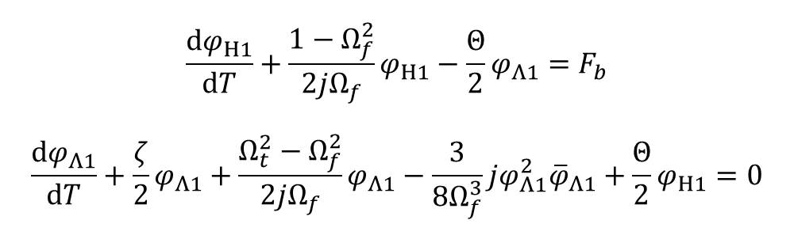
Hysteresis
$$\frac{d^{2}Η_{1}}{dT^{2}}+Η_{1}−Θ\frac{dΛ_{1}}{dT}=F_{v}e^{j\frac{ω_{v}}{ω_{1}}T}+F_{b}e^{j\frac{ω_{b}}{ω_{1}}T}+c.c.$$
$$\frac{d^{2}Λ_{1}}{dT^{2}}+ζ\frac{dΛ_{1}}{dT}+\frac{ω_{t}^{2}}{ω_{1}^{2}}Λ_{1}+Λ_{1}^{3}+Θ\frac{dΗ_{1}}{dT}=0$$
Assume that $F_{v}=0$
$$\frac{dφ_{Η1}}{dT}+\frac{1−Ω_{f}^{2}}{2jΩ_{f}}φ_{Η1}−\frac{Θ}{2}φ_{Λ1}=F_{b}$$
$$\frac{dφ_{Λ1}}{dT}+\frac{ζ}{2}φ_{Λ1}+\frac{Ω_{t}^{2}−Ω_{f}^{2}}{2jΩ_{f}}φ_{Λ1}−\frac{3}{8Ω_{f}^{3}}jφ_{Λ1}^{2}{\overline{φ}}_{Λ1}+\frac{Θ}{2}φ_{Η1}=0$$

Slide 13
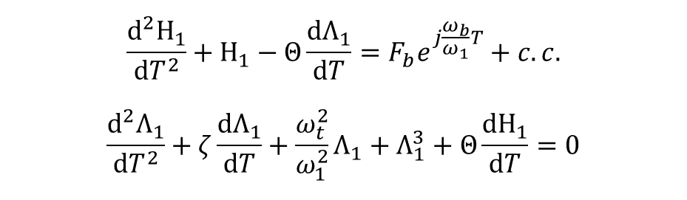

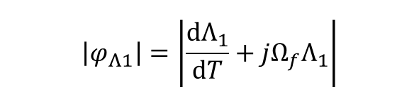
Trivial initial condition
$$\frac{d^{2}Η_{1}}{dT^{2}}+Η_{1}−Θ\frac{dΛ_{1}}{dT}=F_{b}e^{j\frac{ω_{b}}{ω_{1}}T}+c.c.$$
$$\frac{d^{2}Λ_{1}}{dT^{2}}+ζ\frac{dΛ_{1}}{dT}+\frac{ω_{t}^{2}}{ω_{1}^{2}}Λ_{1}+Λ_{1}^{3}+Θ\frac{dΗ_{1}}{dT}=0$$
Due to the overshoot, the higher branch is excited with trivial BC
Count $\left|φ_{Λ1}\right|$ at $T=3000$
$$\left|φ_{Λ1}\right|=\left|\frac{dΛ_{1}}{dT}+jΩ_{f}Λ_{1}\right|$$
Simulate the system from trivial initial conditions

Slide 14

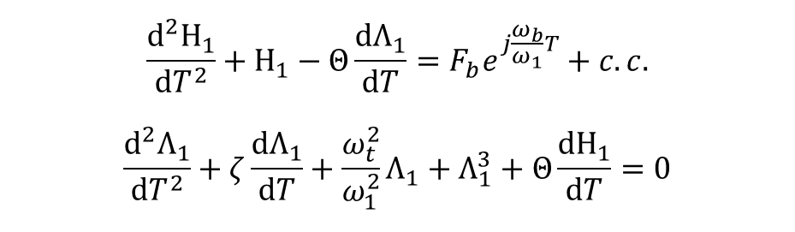


Lower branch initial condition
$$\frac{d^{2}Η_{1}}{dT^{2}}+Η_{1}−Θ\frac{dΛ_{1}}{dT}=F_{b}e^{j\frac{ω_{b}}{ω_{1}}T}+c.c.$$
$$\frac{d^{2}Λ_{1}}{dT^{2}}+ζ\frac{dΛ_{1}}{dT}+\frac{ω_{t}^{2}}{ω_{1}^{2}}Λ_{1}+Λ_{1}^{3}+Θ\frac{dΗ_{1}}{dT}=0$$
$$2w_{0}=1μm$$
$$F_{b}=−0.0146$$
Compute the IC based on the lower branch solution of $φ_{Λ1}$ and $φ_{Η1}$
Lower branch steady-state solution is excited

Slide 15

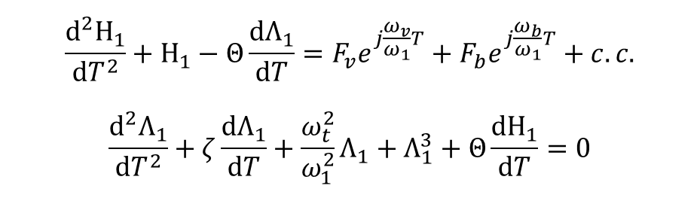



Quasiperiodic modulation
$$\frac{d^{2}Η_{1}}{dT^{2}}+Η_{1}−Θ\frac{dΛ_{1}}{dT}=F_{v}e^{j\frac{ω_{v}}{ω_{1}}T}+F_{b}e^{j\frac{ω_{b}}{ω_{1}}T}+c.c.$$
$$\frac{d^{2}Λ_{1}}{dT^{2}}+ζ\frac{dΛ_{1}}{dT}+\frac{ω_{t}^{2}}{ω_{1}^{2}}Λ_{1}+Λ_{1}^{3}+Θ\frac{dΗ_{1}}{dT}=0$$
$$2w_{0}=1μm$$
$$F_{b}=−0.0146$$
$$2v_{0}=1V$$
$$F_{v}=0.0052$$
Plot $\left(F_{v}e^{j\frac{ω_{v}−ω_{b}}{ω_{1}}T}+F_{b}\right)e^{j\frac{ω_{b}}{ω_{1}}T}+c.c.$ versus $T$

Slide 16
Concluding Remark
We have designed a piezoelectric system with base excitation and two piezoelectric patches
Shunted with cubic nonlinear circuits, such piezoelectric beam exhibit hysteresis loop
We can apply voltage signal with the frequency close to the base excitation to modulate the effective amplitude
Such quasiperiodic modulation can lead to the switching between lower and higher branches of the hysteresis
Potential next steps:
Analyze the power flow
Simulate the full system (the beam) to confirm our results
Optimize our system to adapt to the engineering need

